Slide 1
Active Learning
review of
“Active learning Methods for Remote sensing Image Classification”
June 22nd 2017
Kunwoo park

Slide 2
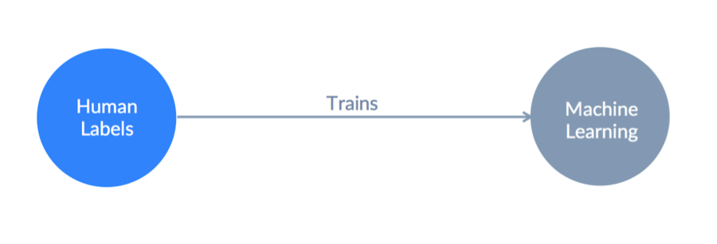
Training data
Supervised machine learning
Quality and quantity of training data is the most important
Never ending process
ARTIFICIAL INTELLIGENCE AND THE FUTURE OF WORK. (February 14, 2017). from https://lukasbiewald.com/

Slide 3
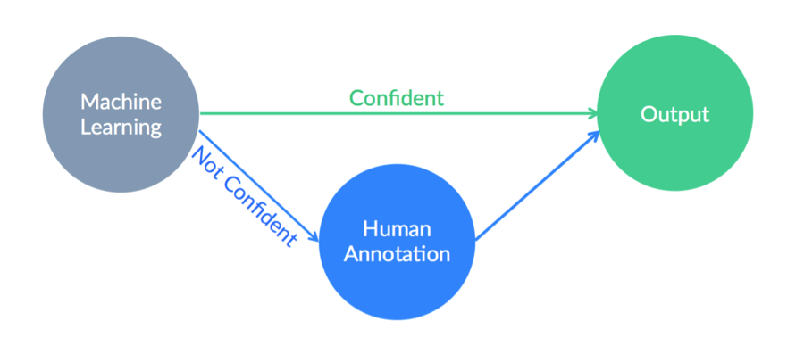
Human-in-the-loop
A machine does an “easy job”
A human does a “complicated job”
ARTIFICIAL INTELLIGENCE AND THE FUTURE OF WORK. (February 14, 2017). from https://lukasbiewald.com/

Slide 4
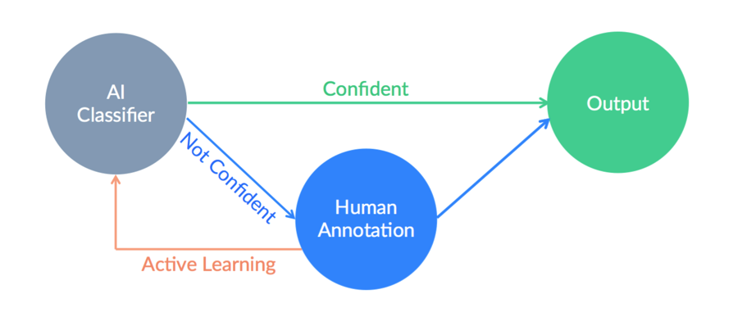
Active Learning
The training data collected by the “Human in the Loop” can be fed back into the algorithm to make it better.
ARTIFICIAL INTELLIGENCE AND THE FUTURE OF WORK. (February 14, 2017). from https://lukasbiewald.com/

Slide 5
Paper
Tuia, Devis, et al. "Active learning methods for remote sensing image classification." IEEE Transactions on Geoscience and Remote Sensing 47.7 (2009): 2218-2232.

Slide 6
Introduction
SVM (kernel method)
1) Valuable generalization properties
2) Ability to handle high-dimensional feature spaces
3) Uniqueness of the solution
Cons : rely on the quality of labeled data -> Active learning!

Slide 7
3 different ways of active learning
1) SVM specificity (e.g., margin sampling)
Takes advantage of geometric features of SVM
2) Rely on the estimation posterior probability distribution function of classes
High cost computation
3) Query by Committee (e.g., Boosting bagging)
Select the samples where the disagreement between the classifiers is maximal

Slide 8
Methodology
1) Margin Sampling by closest support vector(MS-cSV)
2) Entropy Query-by- Bagging(EQB)

Slide 9
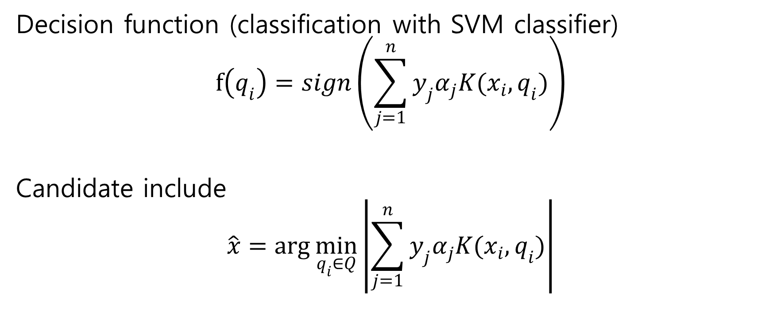
Algorithm - MS
Decision function (classification with SVM classifier)
$$f\left(q_{i}\right)=sign\left(\sum_{j=1}^{n}{y_{j}α_{j}K(x_{i},q_{i})}\right)$$
Candidate include
$$\hat{x}=\arg{\min_{q_{i}∈Q}\left|\sum_{j=1}^{n}{y_{j}α_{j}K(x_{i},q_{i})}\right|}$$

Slide 10
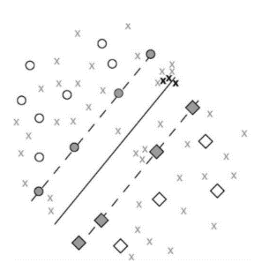
Algorithm - MS
Weakness
When several adjacent points are close to hyperplane, candidates from the same neighborhood will be chosen.

Slide 11
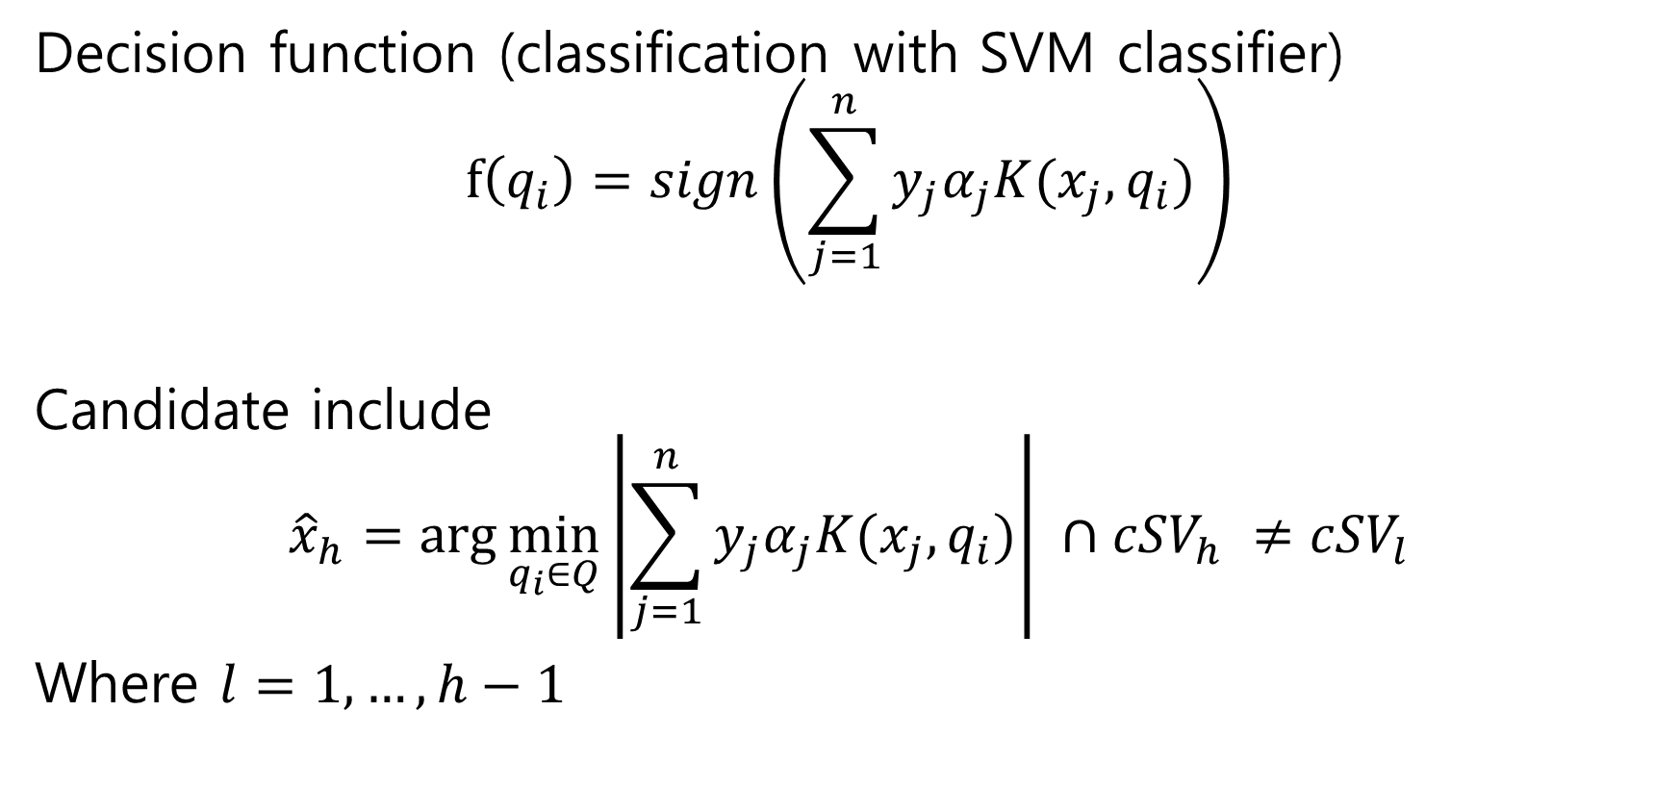
Algorithm – MS-cSV
Decision function (classification with SVM classifier)
$$f\left(q_{i}\right)=sign\left(\sum_{j=1}^{n}{y_{j}α_{j}K(x_{j},q_{i})}\right)$$
Candidate include
$${\hat{x}}_{h}=\arg{\min_{q_{i}∈Q}\left|\sum_{j=1}^{n}{y_{j}α_{j}K(x_{j},q_{i})}\right| ∩{cSV}_{h} ≠{cSV}_{l}}$$
Where $l=1,…,h−1$

Slide 12
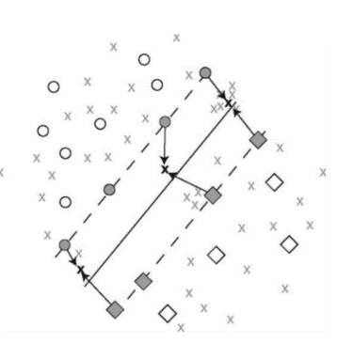
Algorithm – MS-cSV
when confronted with several candidates located in the vicinity of the same support vector, the algorithm only takes into account the candidate associated with the minimal distance to the margin

Slide 13
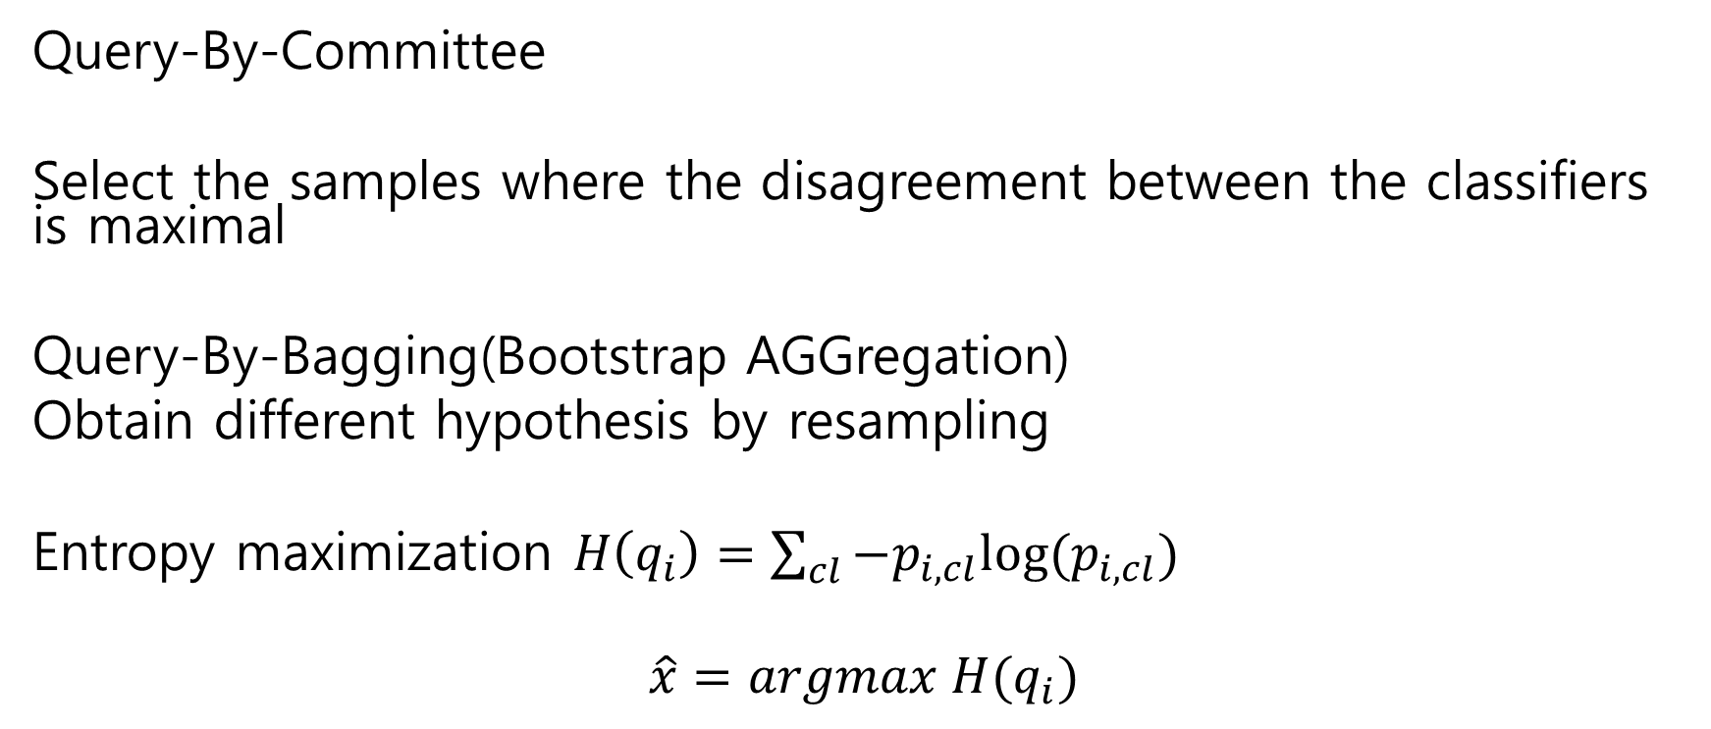
Algorithm – EQB
Query-By-Committee
Select the samples where the disagreement between the classifiers is maximal
Query-By-Bagging(Bootstrap AGGregation)
Obtain different hypothesis by resampling
Entropy maximization $H\left(q_{i}\right)=\sum_{cl}{−p_{i,cl}log⁡(p_{i,cl})}$
$$\hat{x}=argmax H(q_{i})$$

Slide 14
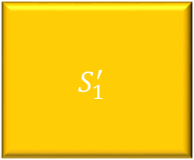
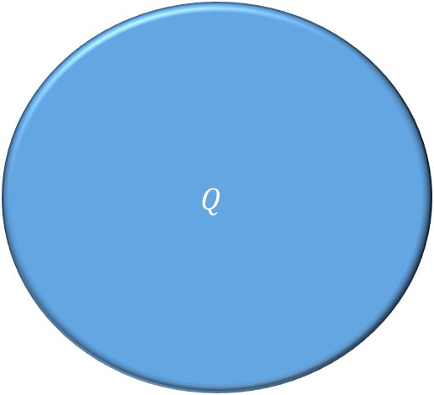
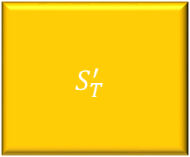
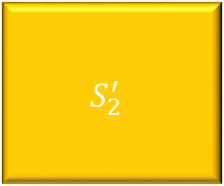
Algorithm – EQB
$$\hat{x} = {arg min}_{q_{i}∈Q }||\{t ≤ k|f_{t}(q_{i}) = 1\}|−|\{t ≤ k|f_{t}(q_{i}) = 0\}||$$
where t is one of the k classifiers and the binary labels are of the form {0, 1}.
If the classifiers agree to a certain classification, (4)is maximized. On the contrary, uncertain candidates yield small values.
$$Q$$
$$S_{1}^{′}$$
$$S_{2}^{′}$$
…
$$S_{T}^{′}$$

Slide 15
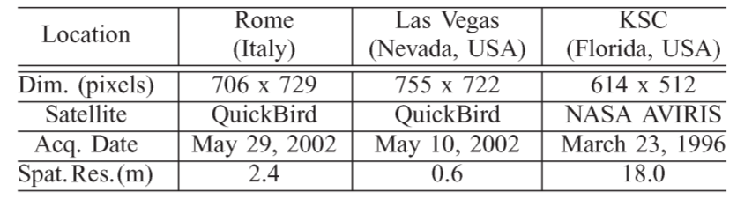
Data sets

Slide 16
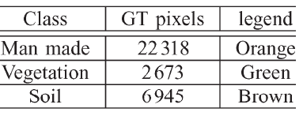
Data sets
Rome
Notes:
High resolution multi sepctral

Slide 17
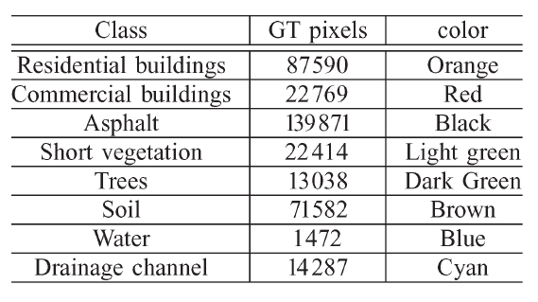
Data sets
Las Vegas
Notes:
Very High resolution multi sepctral

Slide 18
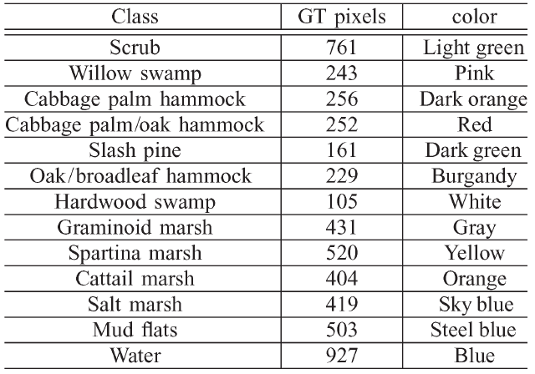
Data sets
KSC
Notes:
Relatively low resolution hypersepctral

Slide 19
Results
MS
MS-cSV
EQB
SRS (upper bound) random selection
SpRS candidates are selected on uniform spatial grid
Full SVM (lower bound)

Slide 20
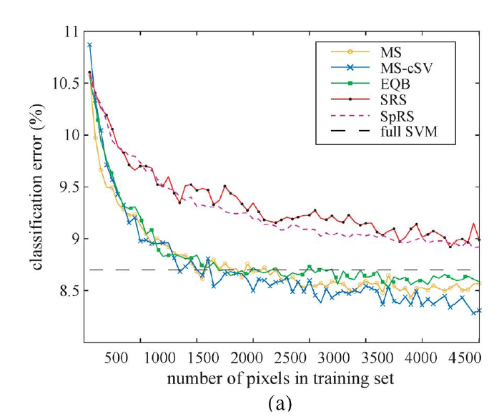
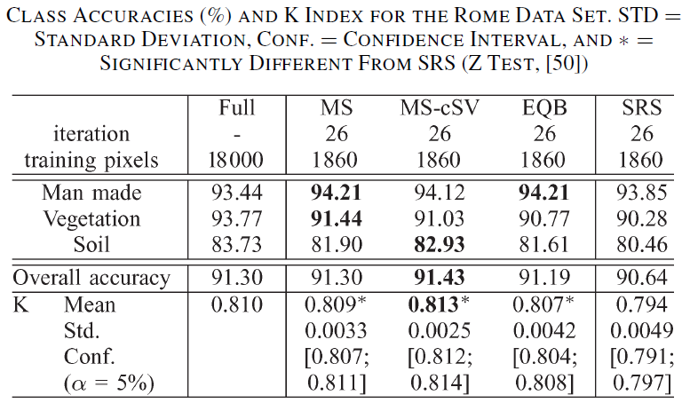
Results - Rome
Notes:
For the Rome data set, the three active algorithms perform similarly and converge to the Full SVM error in about 25 iterations. This corresponds to 10% of the training set used by the Full SVM

Slide 21
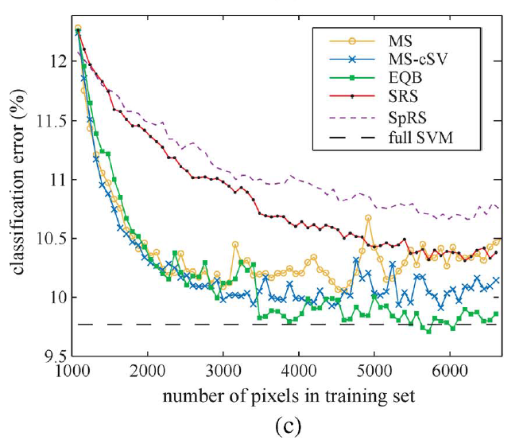
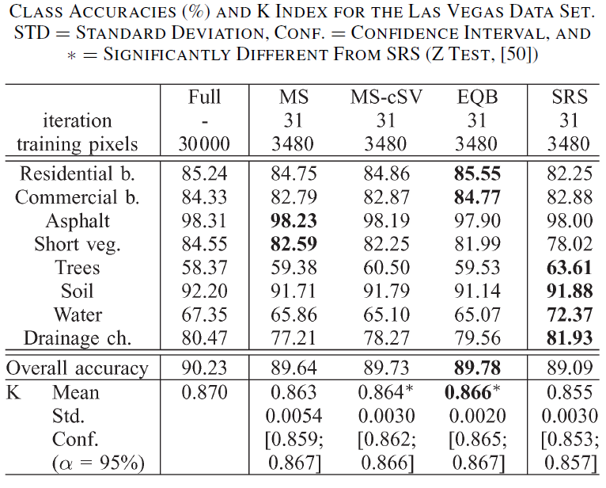
Results – Las Vegas
Notes:
Parameter Reestimation at iteration 30(3400pixel)
MS-cSV performs better that the MS algorithm, taking advantage
of the distribution of the pixels in Q after the first
iterations, where both methods perform similarly. Moreover,
the MS method cannot converge and is equivalent to SRS after
the 50th iteration. An intuitive explanation is that MS-cSV
avoids oversampling in dense regions close to the margin and
samples all the feature space equivalently.

Slide 22
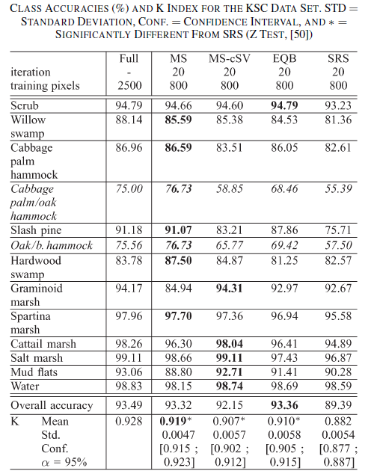
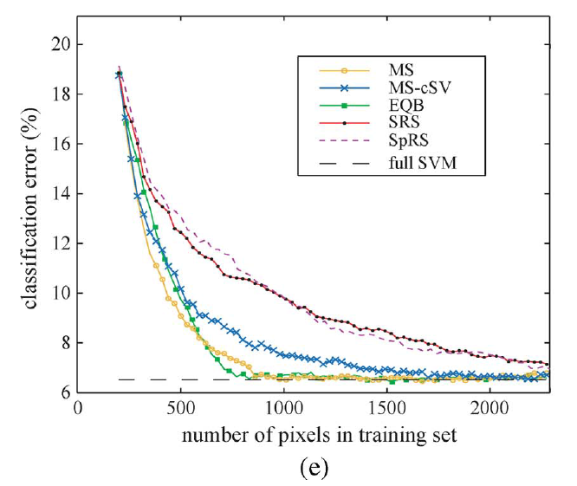
Results - KSC
Notes:
MS-cSV cannot
find the optimal solution for the mixed classes, such as classes
“Cabbage palm/hammock” and “Oak/broadleaf hammock” (in
italic on Table VII).

Slide 23
Results – ill posed scenarios
starting size of X is 13 pixels and adding 30 pixels per iteration
after four iterations, the EQB algorithm starts to outperform SRS and converges to the Full SVM result when using about 800 pixels

Slide 24
Conclusion
Using active learning algorithm, accuracy could converge to full SVM even when using a small number of training points.
The performances of the method are at least comparable to that of the MS, which is optimal for SVMs.
Issues related to too very small objects such as cars in VHR imagery and the problems that are raised by their inclusion in the training set have been addressed.
All the active learning methods depend heavily on the quality of the initial data.

Slide 25
Thank you!

